Slide 1
Photodiode in Optical Fiber Communication

Slide 2
Introduction
A photodiode is a semiconductor device that detects light and converts it into an electrical current.
In optical fiber communication, it is used at the receiver end to detect light signals transmitted through the fiber.
Photodiodes are fast, sensitive, reliable, and essential for high-speed data communication.

Slide 3
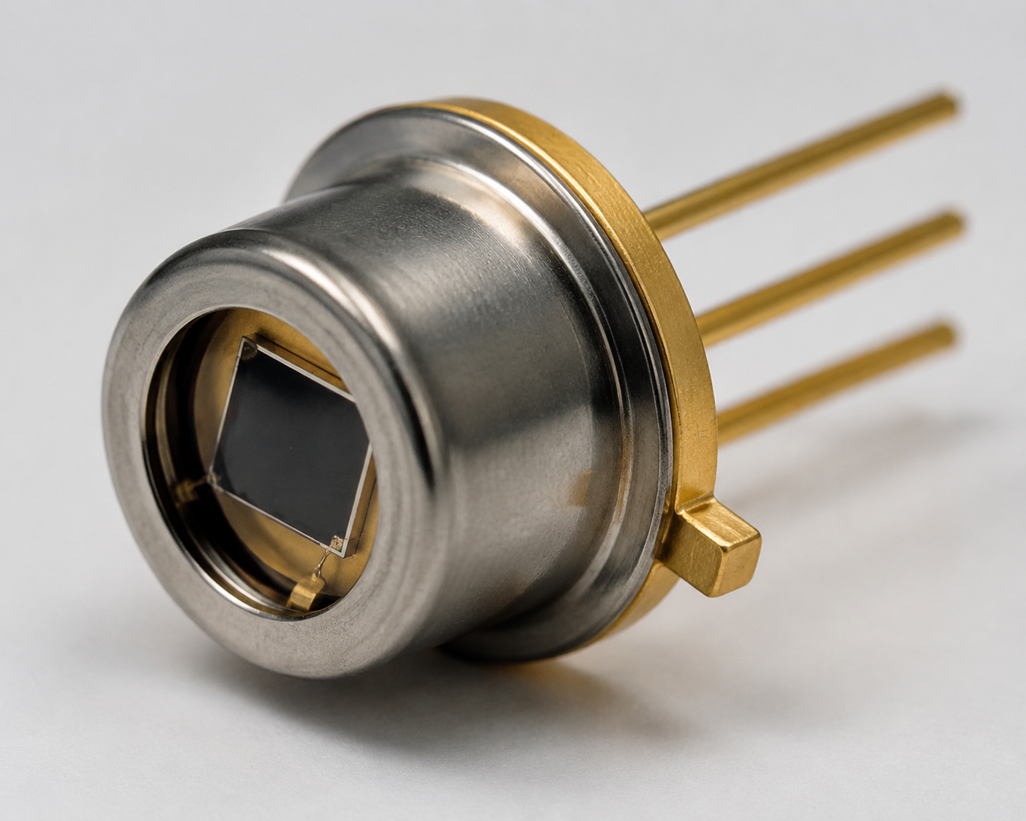
Figure: InGaAs photodiode in a TO-can package, commonly used in optical fiber communication receivers for converting incoming light signals into electrical currents with high sensitivity and fast response. It has high responsivity in the 800–1700 nm wavelength range, which matches common fiber communication wavelengths (850 nm, 1310 nm, 1550 nm).

Slide 4
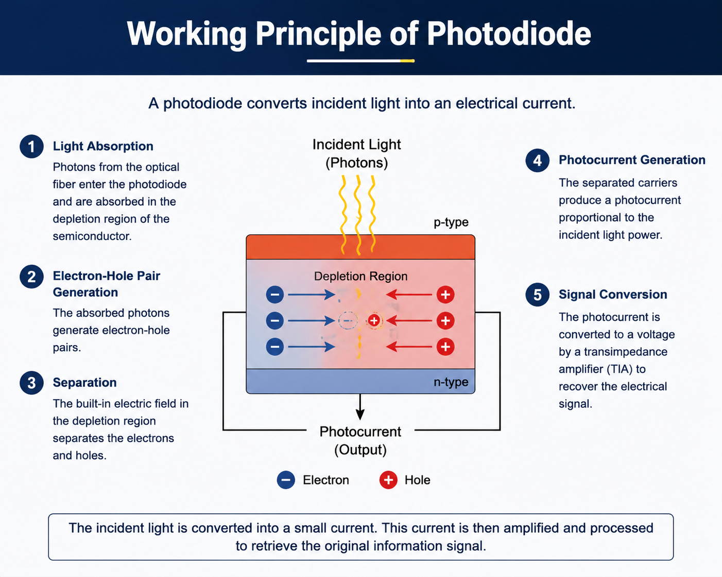

Slide 5
Key Features
High Speed: Detects very fast light signals
High Responsivity: Efficiently converts light into electrical current.
Low Noise: Good signal-to-noise ratio.
Wide Wavelength Range: Works in 400–1700 nm range.
Compact Size: Suitable for high-density systems.
High Reliability: Long-term stable operation.

